Slide 1
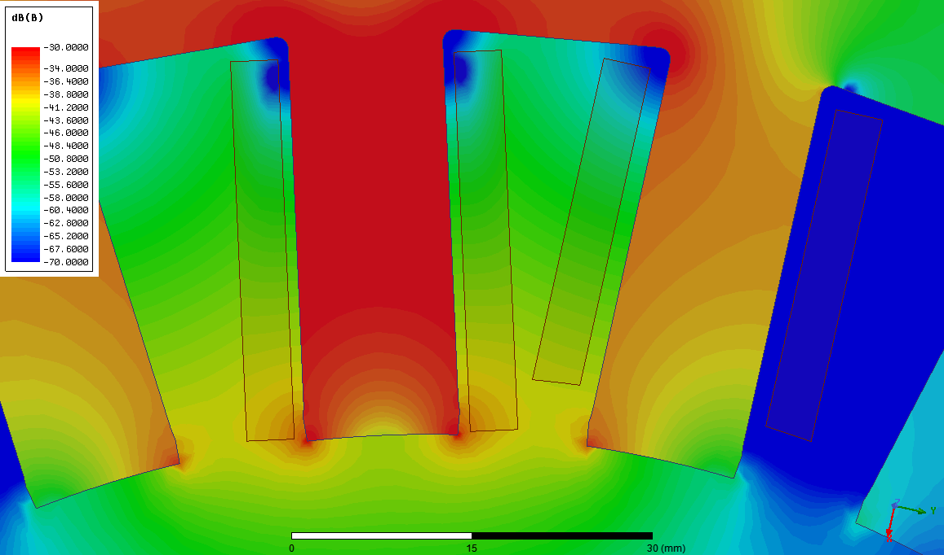
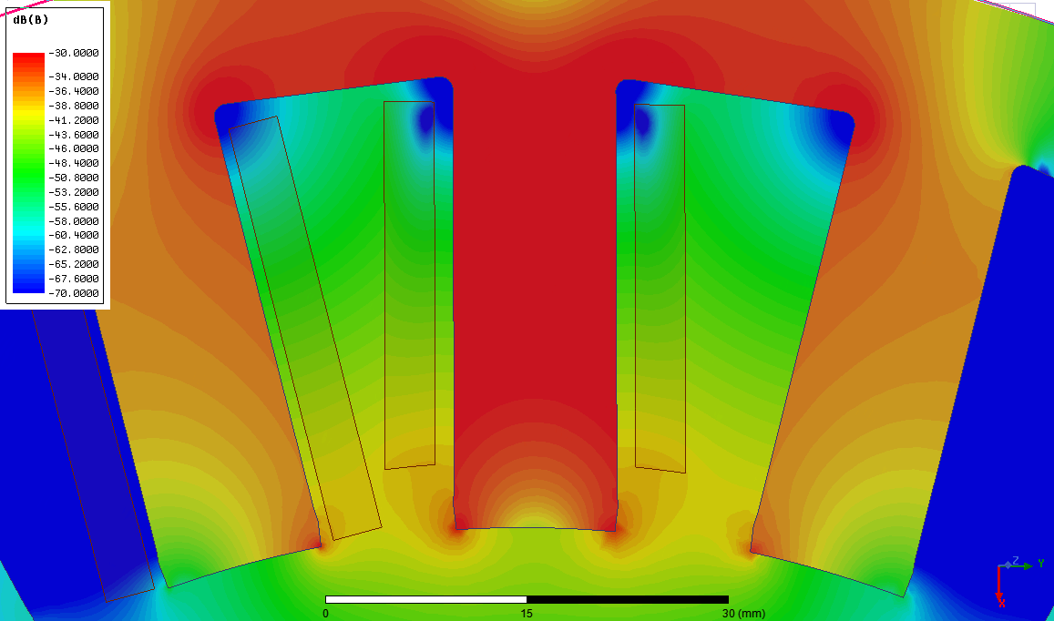
Longer Window
Shorter Window

Slide 2
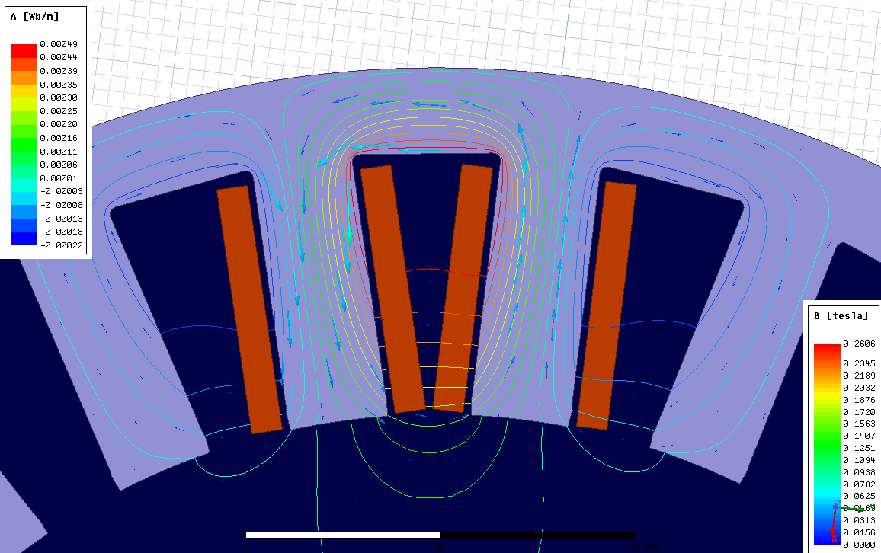
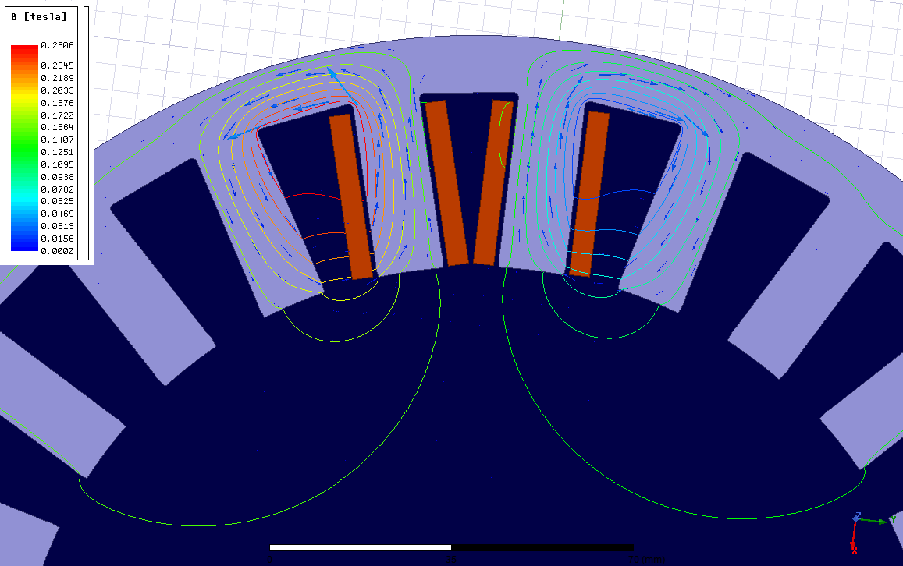
Flux Paths of Different End Winding Connection Types
Opposite Direction
Same Direction

Slide 3
Calculations
Single Coil
Opposite Direction
Same Direction
Magnetic Circuit:
MMF = NI
Reluctance: R/2
Flux: 2Φ
Flux Linkage: 2λ
Inductance: 2L
Maxwell: 1.10 mH
Magnetic Circuit:
MMF = 2NI
Reluctance: R
Flux: 2Φ
Flux Linkage: 4λ
Inductance: 4L
Maxwell: 3.12 mH
Magnetic Circuit:
MMF = NI
Reluctance: R
Flux: Φ
Flux Linkage: λ x 2
Inductance: L x 2
Maxwell: 1.18 mH

Slide 4
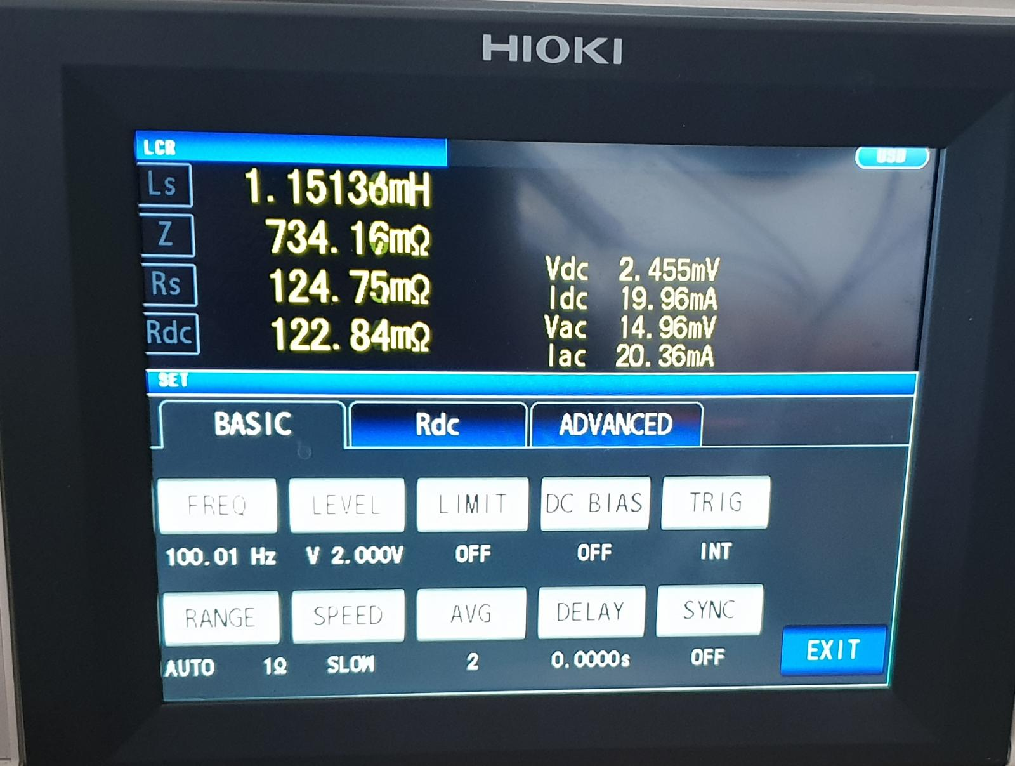
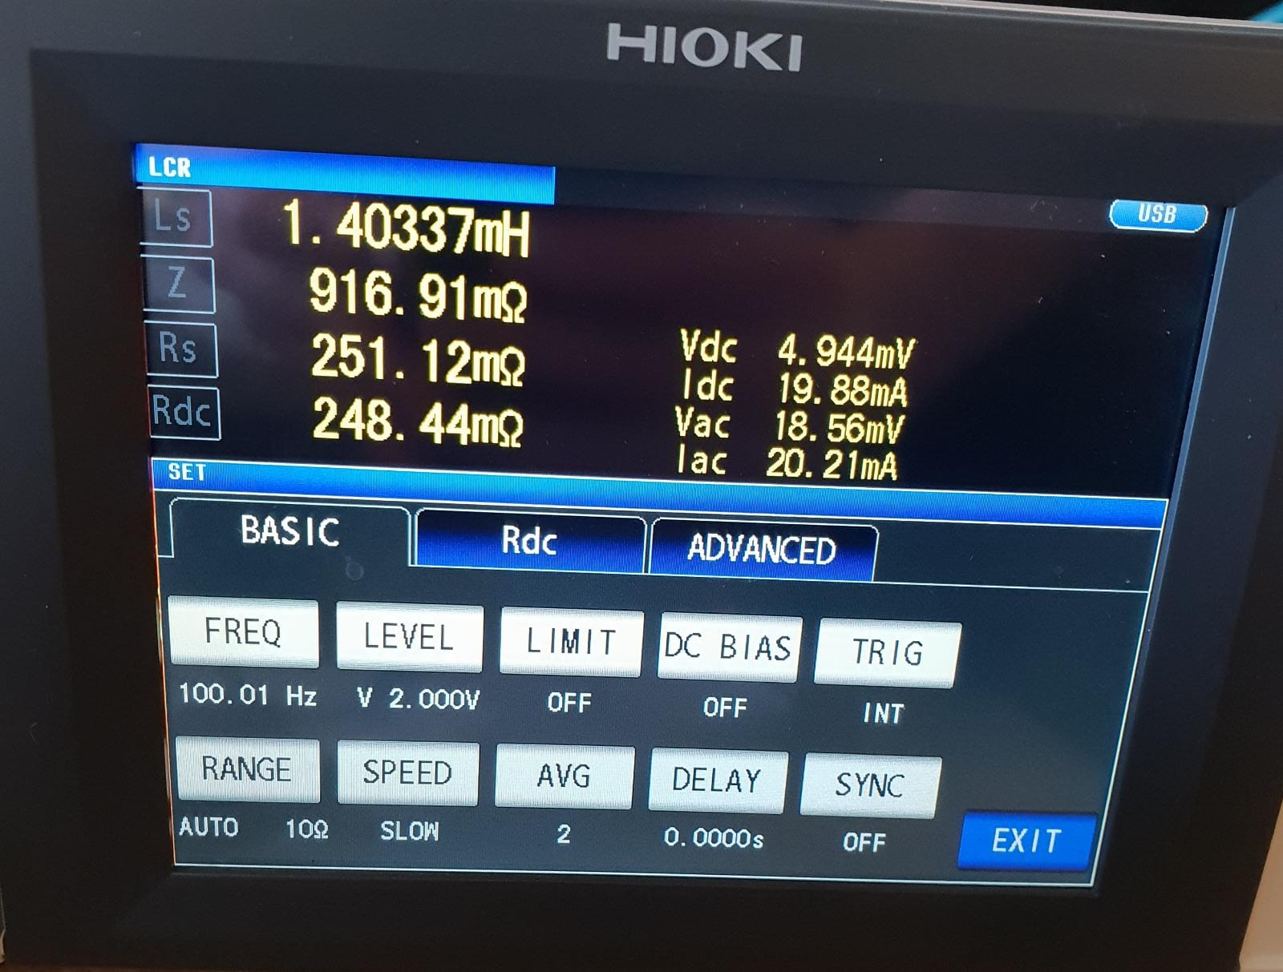
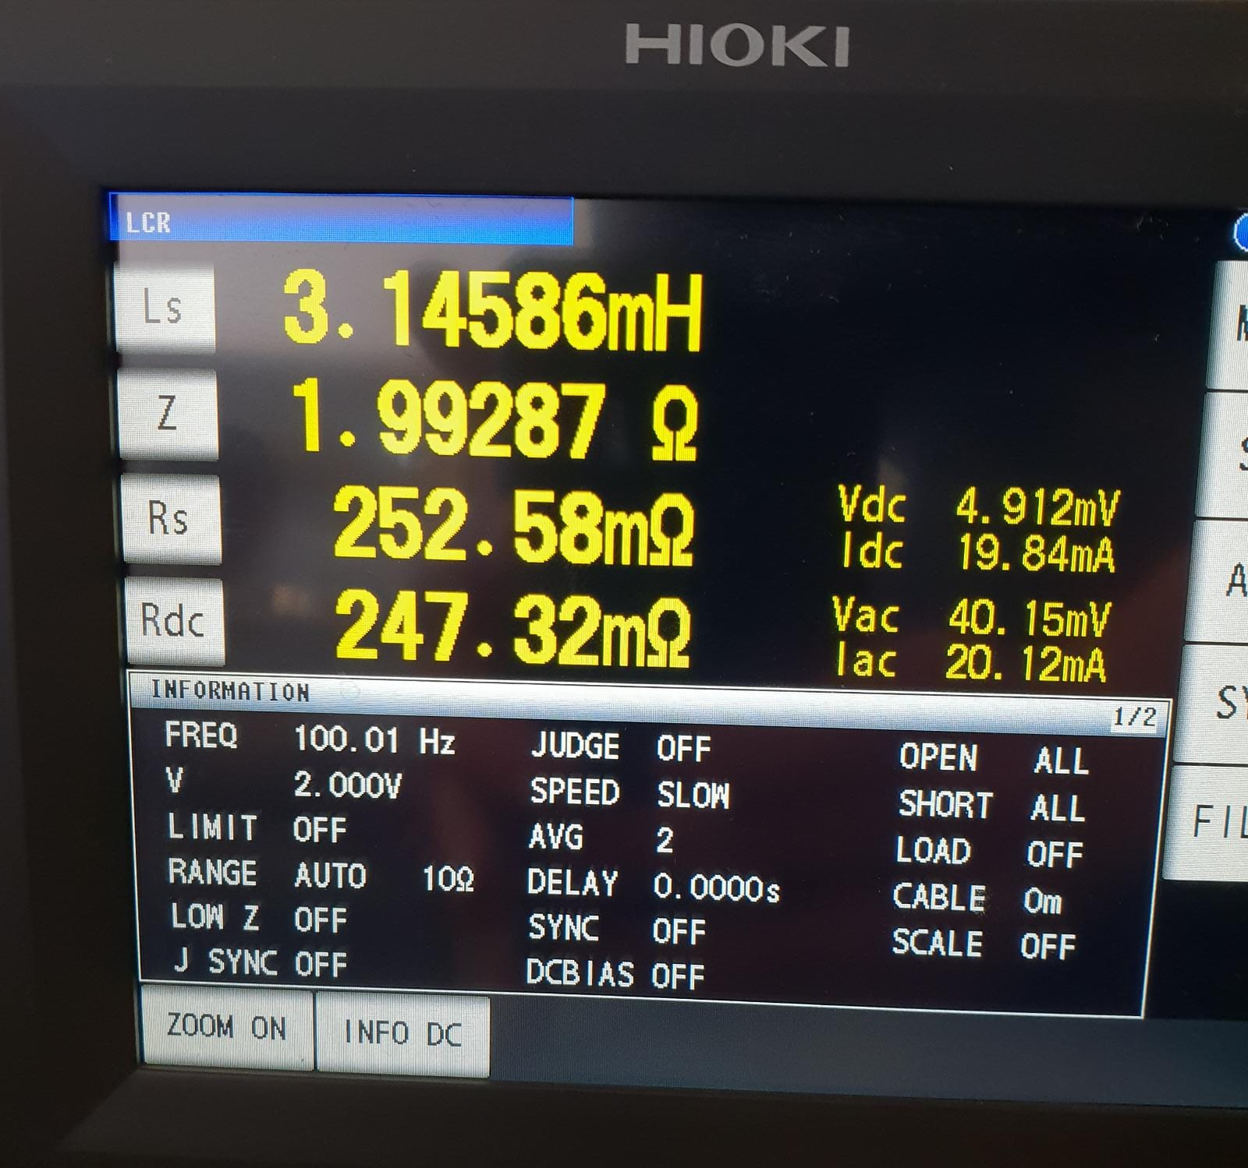
Measurement
Single Coil
Opposite Direction
Same Direction

